Slide 1

Module 7: What is New in the 2018 Sphere Handbook?
Notes:
Before using this slideshow:
Read the accompanying guidance notes
Delete unneeded slides
This slide:
Remove “company name” and the vertical line next to it, or replace with you own logo(s)
To change the date, select Slide Master from the View menu. When done, click Close Master View to return.

Slide 2


Learning objectives
By the end of this session, you will be able to recall:
the challenges in the sector which became the drivers of the Handbook revision,
the approach to and results of the revision process,
the key changes between the 2011 and 2018 editions,
how Sphere has evolved and what new products are on offer;
and you will be able to discuss:
how the 2018 edition is adapted to the current contexts in which its users operate.
Knowledge
Comprehension
2
Notes:
Slide for training seminars/webinars only – delete for presentations

Slide 3

Today’s challenges and drivers of the revision
3
Notes:
This is a summary of the following 5 slides. For a shorter presentation, keep this one but delete the following 5. For longer presentations, you could delete this one.

Slide 4

Learning and new evidence
Syrian conflict and refugee crisis
Issues of access, capacity building, protracted displacement, civilian and aid worker security, etc.
→ e.g. Shelter and Settlement
Outbreaks of Ebola, cholera and plague
→ e.g. WASH
Ben Parker/IRIN

Slide 5
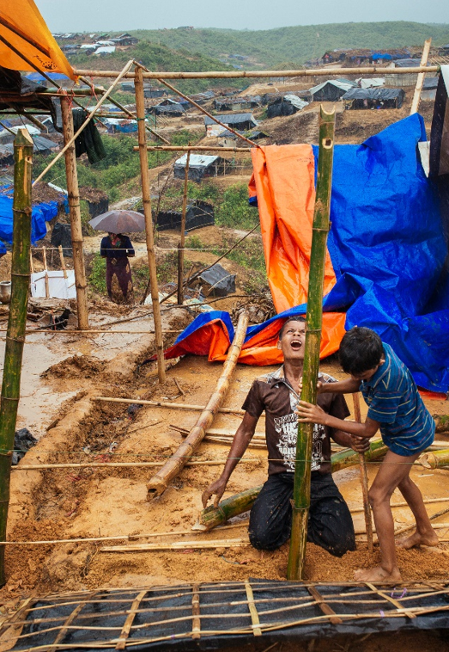
Benjamin Suomela/Finnish Red Cross
Evolving operating contexts
Protracted, complex and recurring crises
Urban vs. rural settings and communal settlements
Settings with increasingly diverse operational actors
Climate change and environmental impact in humanitarian response

Slide 6
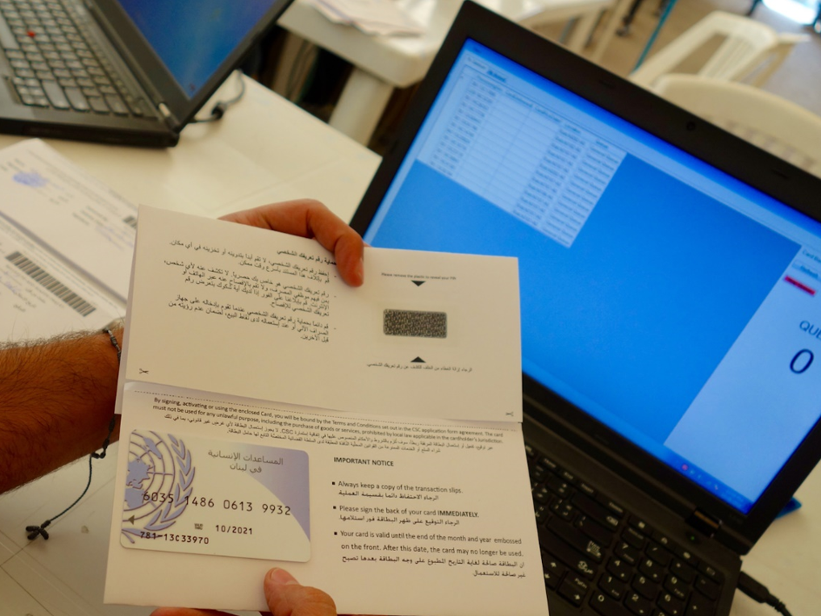
Fundamental shifts in how assistance is provided
Market-based programming, including cash transfers, and other assistance options
→ Implications for protection, accountability and quality monitoring
Ben Parker/IRIN

Slide 7
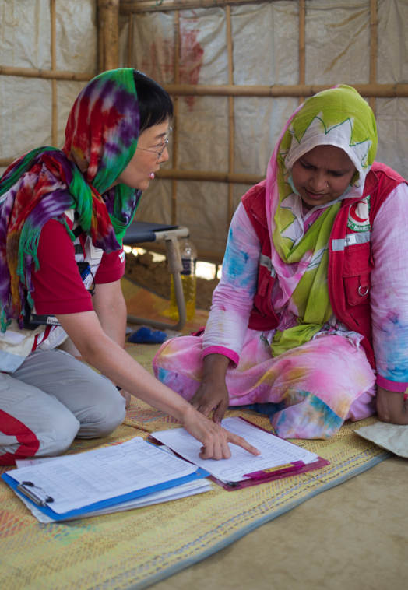
Community engagement and accountability
Renewed attention to accountability with further learning
Participation
Supporting local actors
Working with local authorities
Core Humanitarian Standard
A.J. Ghani/IFRC

Slide 8

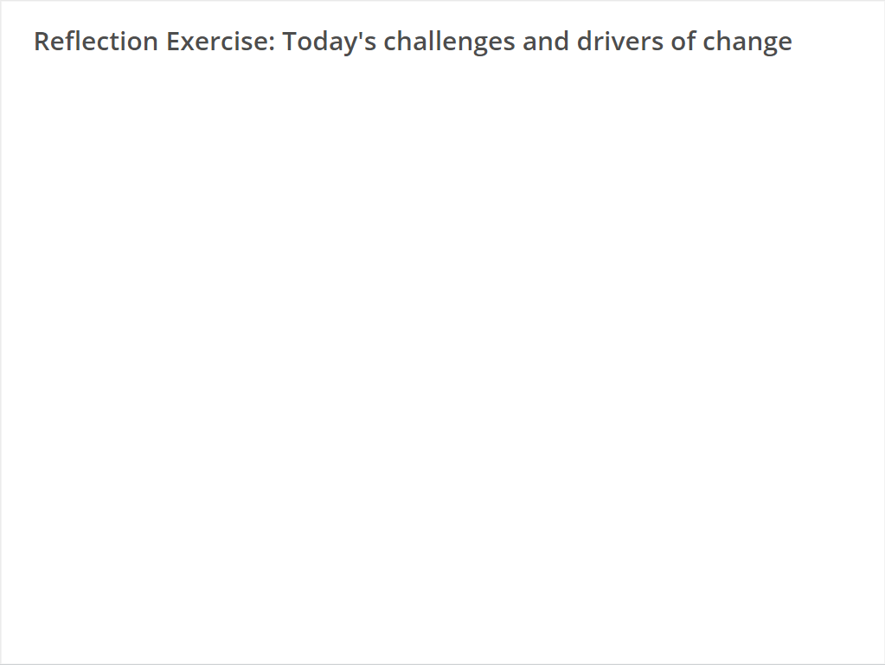
Quiz
Click the Quiz button to edit this object

Slide 9

Structural CHANGES to the Handbook:
Standards are more outcome-oriented
Key actions are presented with sub-actions
Guidance notes are more concise
Indicators are reformulated
Foundation chapters are better integrated in technical chapters
Overall structure largely unchanged
9
Notes:
The set of CHANGES slides (12 starting with this one) should be the core content of your presentation/workshop.

Slide 10
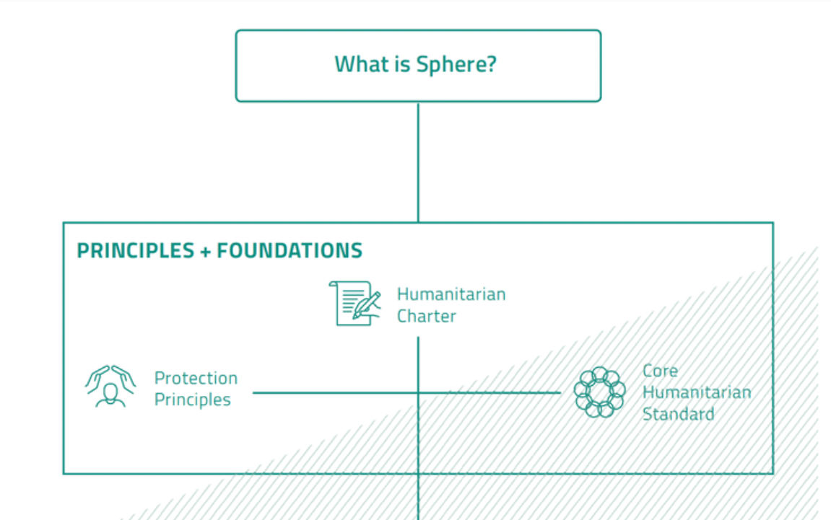
Foundation chapters
What is Sphere? revised
Humanitarian Charter reviewed and unchanged
Protection Principles revised
Core Humanitarian Standard partially revised, replaces the Core Standards
Notes:
This slide is a summary of the following 4.

Slide 11
Where we are now
Focus on people, community engagement and supporting local action
Great attention to use in context
Simplified language and presentation
Decisions tracked and documented
11
Notes:
This serves as a summary of the CHANGES slides above.

Slide 12
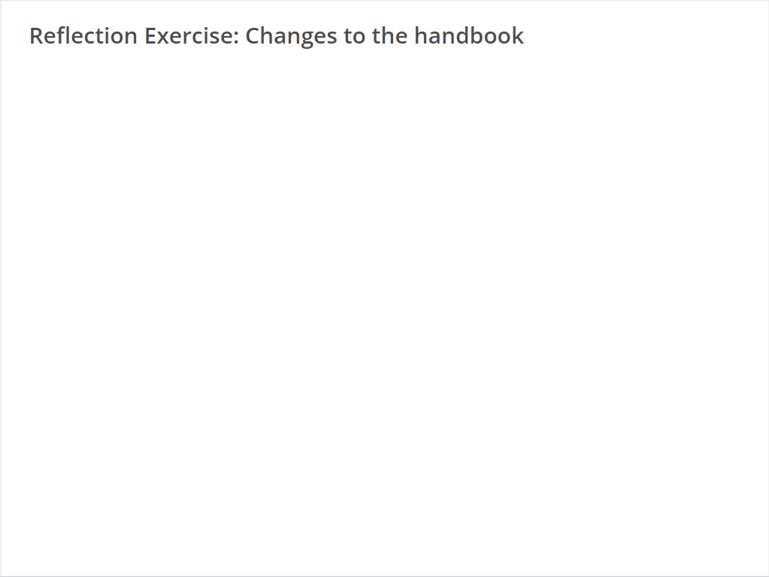
Quiz
Click the Quiz button to edit this object

Slide 13

A NEW IDENTITY
Discover the Sphere Standards
Sphere offers an extensive library of materials and tools to expand your knowledge and understanding of humanitarian standards.
Share your experience
Join a vibrant global community, committed to improving quality and accountability across the humanitarian sector.
Put standards into practice
Sphere strengthens your advocacy for improvements on the ground.
spherestandards.org
Notes:
Depending on your context, delete some or all of the SPHERE set of slides (4 starting with this one).
The Interactive Handbook and Sphere Champion e-learning were launched at the same time as the Sphere Handbook.
The more time that has passed since November 2018, the less relevant it is to promote these as NEW products.

Slide 14
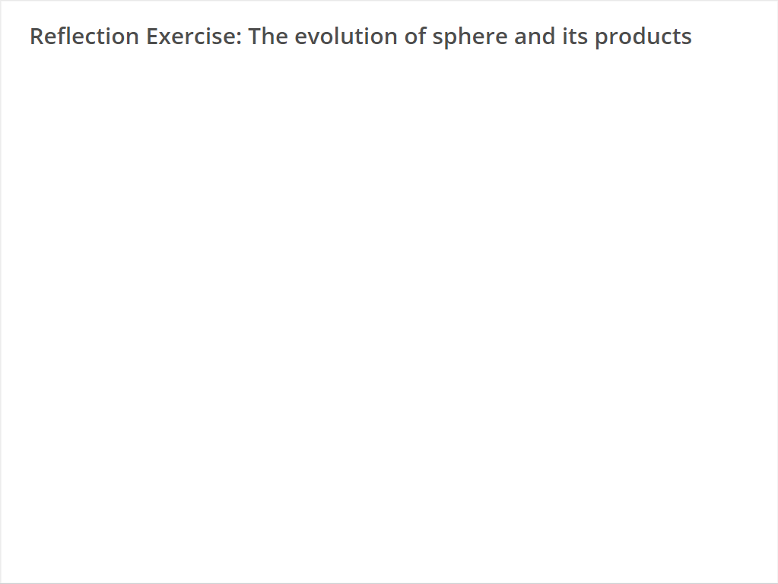
Quiz
Click the Quiz button to edit this object

Slide 15
Notes:
To update the details, select Slide Master from the View menu. When done, click Close Master View to return.

Slide 16


